Slide 1

Inclusive Housing Toolkit #2
Family-Led Initiatives
Created by SHS Consulting
For My Home My Community

Slide 2




Acknowledgements
This report was produced as part of My Home My Community, a national initiative of the
Canadian Association of Community Living and People First of Canada.
Inclusive Housing Options for People with Developmental Disabilities received funding from
the National Housing Strategy under the NHS Demonstrations Initiative to produce this work.
The views expressed within are solely of the Canadian Association for Community Living, together
with project partners where expressly stated. Canada Mortgage and Housing Corporation (CMHC)
accepts no responsibility for the views expressed within.

Slide 3
Inclusive Housing Toolkit
What is it?
An overview guide on the pathways to replicating different models of inclusive housing for individuals with developmental disabilities
A reference tool that breaks down the process into digestible pieces, with tips and specific tools, to be be adapted for your unique housing project
Who is it for?
Organizations, communities, individuals, and families who are interested in kick-starting the development of inclusive housing
Project leaders, managers, and development teams who want to learn from the experiences of other organizations
About the Toolkit
Based on the development journey of the Legacy Homes Case Study, this toolkit maps out a path to replicating this inclusive model
The information is organized into three levels:
  Project phases
  Major activities
  Tools and Guides

Slide 4
Introducing the Series
  This is one of three development pathways detailed in this series. Each explores a different model for producing inclusive affordable housing for people with developmental disabilities.
Toolkit 1 Partnering with Developers | Toolkit 2 Family-Led Initiatives | Toolkit 3 Agency-Led Development
See www.myhomemycommunity.ca to access the full series, including toolkits and case studies, along with other resources to provoke and promote inclusive affordable housing for people with developmental disabilities.

Slide 5
Model 2 : A Home in the Community
About the Model
Considerations
This model (as demonstrated by Brockville Legacy Homes) can be executed as an individual and/or family-led housing solution with a local ACL partnership.
This inclusive model involves an organization acquiring scattered, independent homes in the community, selected by individuals with developmental disabilities and their support circle. Lifelong lease agreements are then provided to individuals to ensure stability of tenure, while supports are planned around the person to create a highly personalized way of living.
This pathway to inclusive housing can enable individuals to remain in the community they grew up in, where they may have existing community supports and relationships; however, this depends on the availability and suitability of local real estate
The model may be more feasible in localities where housing costs are comparatively low
The customization of supports ensures this model works for people of varying needs and ages, as long as the supports can be maintained through sufficient funding, circle involvement, and other strategies
This model requires a high degree of initiative and involvement from the individuals’ families and networks of support, which may include equity contributions and ongoing support/maintenance roles
This model requires considerable effort and determination, particularly for a new organization; strong partnerships and ability to access early funding can help get the project off the ground

Slide 6
Key Themes and Principles
Custom Solutions
Circle of Support
Tips for the Process
The separation of housing and supports and the ability to accommodate scattered housing allow individuals to live in a way that works for them.
This model requires a strong “circle of support” whose role is to advocate for the individual, be actively engaged throughout the process, and remain involved to ensure that the individual is well housed and supported.
Document the entire process in detail!
Keep the needs of people close to heart and let the process be informed by the philosophy behind the vision
Involve and consult with different stakeholders and experts as needed throughout the process
Be open to learning and pivoting along your journey; key moments of creativity, flexibility, and collaboration can lead to great solutions
Individuals Lead
Built on Trust
Unlike a group home, the individual has ownership over their space and is able to receive one-on-one, individualized care. This also creates a dynamic in which the role of the support workers is to follow the individual’s lead, while respecting their space.
Trust between organizations, families, and various stakeholders is key to making this model work. These relationships are important for navigating challenges and remaining aligned to the vision.

Slide 7
Pathway to Creating Housing
Discover
Define
Develop
Deliver
Extend
What is the outcome that meets the vision?
What are the actionable steps to creating this outcome?
Who do we need to work with?
What are the pieces we need to develop?
What final preparations do we need to make before we deliver the outcome?
How do we manage the transition from the current situation to the new situation?
What do we need to do to maintain and grow the outcome?
Is the outcome meeting the needs of all stakeholders?
What does the future look like?
What have we learned from our experience?
What is the problem we’re trying to solve?
Who are the stakeholders?
What are the needs of the individuals we serve?
What are we looking for in our approach to the solution?
What is the housing and support model we want to pursue?
What is the vision and concept of our solution?
What do we need to prepare to execute this vision?

Slide 8
Pathway to
Creating Housing
Phase 1 : Discover
Identify a Need for Change
Explore and Research
Consultation
Synthesize
The journey to creating new solutions is often triggered by dissatisfaction with the current state. What are the issues being faced and what are the forces for change? Initial conversations can lead to forming a group dedicated to discussing and pursuing the issue.
Gain inspiration by looking at existing innovative projects and models across Canada and worldwide. Discover background material in research papers, articles, and case studies. Make time to visit places and connect with organizations that have experience. There are also opportunities to attend conferences, workshops, and information sessions (or initiate your own event!).
Hold consultations with a variety of stakeholders to understand their perspectives on housing. Engaging people early in the process is important to gauge interest, gain insights, and gather support. Some of the most promising ideas and leads can emerge from these conversations.
Toward the end of the discovery phase, pull together all the different pieces of information that will help with defining a solution approach.

Slide 9
Consultation
In action:
Format: The consultation process could include several information-gathering activities, from a survey to in-person focus groups. For focus groups, there could be a combination of separate conversations with particular stakeholder groups and larger group conversations to bring the perspectives together.
Materials: A list of questions
Method: Consultation sessions may be facilitated by project leaders or volunteers. The session could be an open room discussion or include some conversations in smaller groups, with a share at the end. It is important to have a designated note-taker and/or use handouts for participants to record their thoughts on.
Tool Discover
Description:
Consultations are used to gather insights from stakeholders, such as individuals with a disability, their families, staff members, community members, and other experts. The goal is to have structured conversations and hear from different perspectives, particularly the individuals and their advocates, on what an ideal home and life would look like. Some of the outcomes might include identifying the needs of individuals and other stakeholders, discussing values and philosophy, and coming up with some initial solution directions.
Topics for Discussion
What is the concept of “home” for individuals with a disability?
What are the current challenges to securing housing
How would people like to live?
What do people need to succeed?
What does inclusivity look like?
What are the guiding or design principles?
What are the hopes and fears for the process and outcome?
Notes:
*Look at what UNITI Chorus did

Slide 10
Synthesis
Tool Discover
In action:
Format: Synthesis could be done in stages. It might start with a collaborative session where project leaders get together to sift through information, before dividing up tasks.
Method:
  Look at all the materials and notes
  Look for key insights, patterns
  Categorize and prioritize information
  Summarize into guiding document(s)
  Validate with stakeholders
Description:
To wrap up the discovery phase, synthesis is a step to summarize all the information gathered and key insights into tangible outputs that can be shared and used in later parts of the project. This could be done by the project team and, as an extra step, validated by stakeholders who were involved in the consultation process.
Sample Outputs
A summary of the problems with the current state and what do people need or want
A mission statement and list of guiding principles: what are the goals and what are the values that guide us?
A definition of “home” and inclusivity
A list of parties who are interested in the project or wish to be involved
Notes:
*Could include an example of Brockville/UNITI values, mission statement

Slide 11


Pathway to
Creating Housing
Phase 2 : Define
Create Processes and By-laws
Vision and Concept
Organization
Structure
Using the synthesis of insights and guiding principles, begin working on solidifying the project vision.
Holding a visioning session that brings together various stakeholders can help with narrowing in on a cohesive vision.
This model may require creating a new organization, such as a non-profit charitable housing corporation, dedicated to the acquisition and management of housing. It is also important to look into potential partners that can provide the support piece.
A critical step that sets up the journey to acquiring homes is to put processes and procedures into writing. This includes corporation by-laws and policies and procedures for finance, purchase of properties, and property management. Processes and by-laws should be created with the help of a legal consultant.

Slide 12
Vision and Concept
Tool Define
In action:
Format: The visioning session could be a more hands-on workshop, with a balance of discussion and activities to help generate ideas for the vision.
Materials: Worksheets, synthesis materials (e.g. summary of needs, guiding principles), reference materials (e.g. best practices, an inclusivity guide)
Method:
  Using materials, brainstorm ideas for the solution
  Refine the concept and identify the design priorities and criteria
Description:
Having a vision and concept that can be pursued is a tool to bring the project to life. The vision includes the scope of the project, the design criteria, and ideas of project components. Ideally, this process will involve participation from key stakeholders, as well as project leaders, to “co-design” the vision. A consultant might be brought on at this point to design, facilitate, and summarize the visioning sessions.
Sample Topics
Physical Building: location, types of homes, selection criteria
Tenure and Cost: type of lease, affordability levels
Supports and Services: what kinds of supports, support roles (paid vs. unpaid)
Inclusivity: How do we make sure the vision and concept aligns with our definition of inclusivity

Slide 13
Organization Structure
Benefits of a non-profit housing corporation:
Can purchase units on behalf of individuals who may not be able to obtain a mortgage
Can provide a life-lease to approximate home ownership and ensure tenure after the parents have passed
Owns the units and creates a housing stock dedicated to people with developmental disabilities in perpetuity
Can work with other organizations (e.g. take out mortgages with banks, government agencies etc.) to obtain capital grants and rent subsidies that help make housing affordable
Guide Define
Sample Organizational Structure
Description:
Determining the organization structure is a key step in this phase of the project. It is important to work with a legal advisor who can help to create any new entities, such as a non-profit housing corporation. It may also be important to have a close agency partner that can provide supports. Benefits of working with a well-established and funded agency may include early guidance, essential services, staffing, and some funds for operation. Sharing board members between the organizations can help ensure the all the partners stay aligned with the vision and concept.
Board
shared
members
Board
grants/
subsidies
Other Partners
Non-profit housing corporation
Support Agency Partner
donations
life-lease
mortgage
Circle
Tenant
Home
support
rent subsidies
support

Slide 14


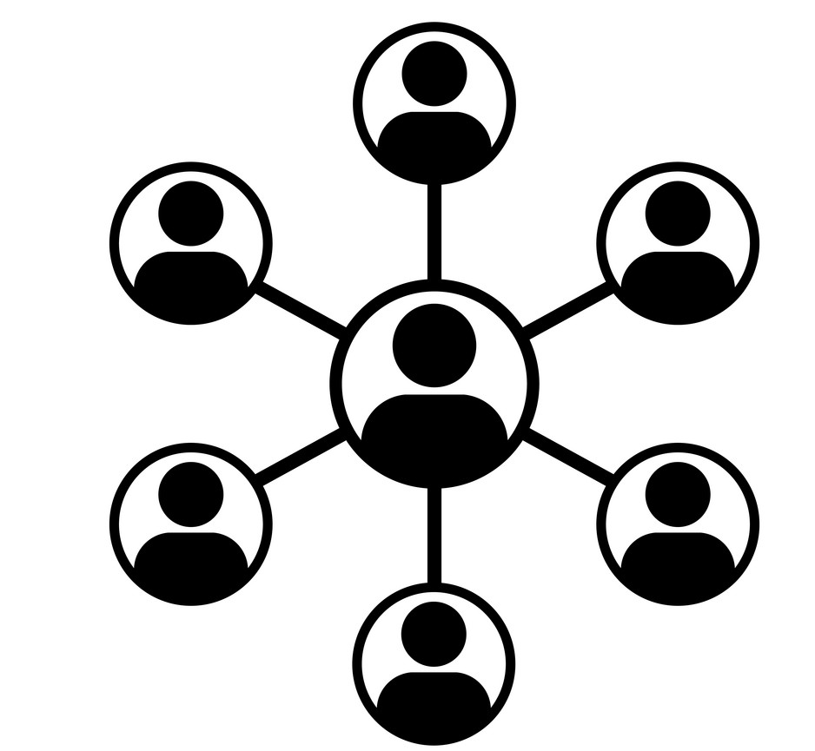
Pathway to
Creating Housing
Phase 3 : Develop
Select Individuals
Support Circle
Select a Home
Finance
Support Plan
From the beginning of the project, there are likely a number of individuals and families that have expressed interest in obtaining a home through this model. It’s important to have extensive conversations with the individual and their circle on their needs to identify how this model might be adapted to the individual.
The “support circle” is a key concept for this model. Members may include an individual’s family members, close friends, and support workers. It is the circle’s responsibility to advocate for the individual and ensure that the housing solution meets the individual’s values, needs, and desires.
The selection process may be entirely driven by the circle of the individual, with some support from the organization. There should be discussions on the criteria for a home. The selected home must be approved by a representative of the board of the housing corporation and undergo inspection, as per the policy.
Various grants and funding may be available to help with purchasing housing. The amount to raise for a down payment will depend on local market prices. The family and/or circle may also be expected to make a contribution towards the down payment in the form of a donation to the organization.
Having a support partner such as a local ACL branch can be crucial for helping to organize the support component. This relationship can range from assisting families with recruitment to managing contracts. A proper support plan for the individual must be in place before the individual moves to their new home.

Slide 15
Select Individuals
In action:
Format: This process involves meetings between the project leaders and the individuals, as well as their families and circles.
Materials: A list of questions
Method: Begin working with individuals and families that have expressed interest in this model. Discuss the needs of the individual, as well as the capacity of the circle and the organization to provide a housing solution that suits their needs.
Tool Develop
Sample Questions
What does home look like for the individual?
What are the requirements for the physical home (e.g. location, house vs. condo, accessibility features)?
What are the requirements for support (e.g. 24-hour care)?
Would the individual be interested in living with a roommate?
What is the budget?
What is the capacity of family and/or circle members? (e.g. being engaged in the process, contributing funds, overseeing supports – see Support Circle p.16 for more details)
Description:
Under this model, the selection of tenants is an ongoing process. As there is more flexibility in the form of housing and supports, the project team needs to ask careful questions to determine what would be a suitable home and what tenants would need in terms of support to live independently. Working with each individual can be resource and time-intensive; the project team might need to prioritize individuals on a needs-basis, such as living in an unsafe situation.

Slide 16
Support Circle
In action:
Format: Having meetings early on can help the circle determine what’s important for the individual and their direct family, as well as how the group works together going forward.
Materials: See Support Circle attachment.
Tool Develop
Who Might be Part of the Support Circle?
Immediate family who are close by
Roommate
Family members living farther away
Description:
The support circle is a key component of this housing model. Each circle’s makeup and functions may be slightly different, but the idea is to have a strong core group that supports the individual through their housing journey, meeting regularly to make decisions with or on behalf of the individual. One of the benefits of having a support circle is that it can advocate for the individual in the spirit of the family, even when direct family is no longer there and the individual cannot advocate for themself.
Friends and neighbours who are close by
People in the person’s network who may offer occasional support, e.g. music teacher
Current and former support workers
immediate
secondary

Slide 17
Home Selection
In action:
Materials: A guide on home selection may be provided to the circles by the project team, based on criteria that is developed from the visioning and the needs of the individual.
Methods:
  The circle coordinates the housing search; the individual should be included in this process, if possible
  Once a property has been ground, the board must determine if the home is suitable for purchase
Tool Develop
Sample List of Considerations
Tenant choice
Form of housing (e.g. bungalow, condo)
Affordability and suitability (e.g. size, number of bedrooms)
Rural vs urban location, proximity to transit, services (such as shops and support agencies) and potential for social connections/inclusivity Accessibility/potential to be modified
Safety and security
Housing condition and adequacy (not in need of major repairs)
Outdoor space and presence of greenery
Accommodating support staff
Sufficient privacy (if there are multiple people sharing the home)
Visitability (for guests)
Description:
A home selection tool can help an individual and their support circle look for a home in the area that could be purchased by the organization. This process may take several months, depending on the availability, price, and selection of real estate in the area.

Slide 18
Tips:
Generally the family will make a non-recoverable donation to the housing corporation to cover the majority of the down payment
Funds for a down payment can also be raised through community and online fundraising
Apply for housing allowances and grants from partners and government agencies
Ensure that the down payment is sufficient for affordable rent, ideally geared to the income of the individual
Potential renovations should be factored into the overall cost of the home
It is more affordable for individuals to share a home with a roommate
Alternatively, allowing families to maintain some equity in the property could also be explored.
Finance
Guide Define
Description:
Obtaining the funds to buy a home can come from several sources. Before the home selection process starts, project leaders should have an idea of whether or not the circle is able to contribute to the down payment, and how much that amount would be. During and after the home selection process, other strategies to find funding may be explored.
Financial Structure
Government funding
Donation from family/circle
Non-profit housing corporation
Rent from tenant
The donation is used to purchase the home
Down payment
Mortgage
The rent is used to pay the mortgage
Home

Slide 19
Support Plan
Guide Define
Tips:
Work on the support component early and in conjunction with finding housing
Identify how much time can be covered by paid support and strategize on how any additional hours may be covered
It could be beneficial to have a roommate without disabilities who could provide light supports in lieu of paid staff; the ideal candidate could be a student or a young professional in need of affordable housing
Have conversations with support staff to ensure alignment on the support philosophy
Potential Elements of the Plan
Description:
It’s important to have a personalized support plan that meets the needs of the individual. The role of the support circle is to help create this plan, in partnership with a support agency of their choosing, unless they already have other sources of support. The plan may consist of supports provided by the partner agency, private staff, a live-in caregiver or roommate, or a combination thereof.
An overview of the support philosophy for the individual that can be provided to support workers
Ads for hiring a support worker or finding a roommate
Information on the person’s preferences, needs, and goals, as well as key information and safety plans
A weekly support schedule, making sure that all the required hours are covered

Slide 20





Pathway to
Creating Housing
Phase 4 : Deliver
Foster
Inclusivity
Acquire Home
Sign Agreement
Preparation for Move-in
Move-in
After an appropriate home is identified, approved, and inspected, the organization makes the down payment using collected funds and secures a mortgage.
A lifelong lease with an affordable monthly rent can guarantee stability of tenure for the individual, while replicating a form of home ownership. Other forms of agreements may also be arranged. Agreements could also be developed and customized to the individual.
The preparation for move-in may be largely organized by the individual and their circle. Depending on the individual, preparation could involve practicing life skills and having discussions about independent living.
Once the home is ready, the individual may move in at once or choose a more gradual approach, beginning with visits and some overnight stays. In the beginning, members of the circle may need to be highly involved to support the transition.
It is essential that the necessary supports are in place before the person moves in.
Around the move-in period, individuals and circles may choose to engage the surrounding neighbourhood to foster inclusion and build relationships. This could be in the form of a housewarming party, as initiated by members of the circle. If the individual is moving to a familiar neighbourhood, existing community relationships should be continued.

Slide 21
Agreement
Tool Deliver
In action:
Materials: A lease, drafted by a legal professional
Method:
  Work with a legal professional to draft a lease agreement that works for your organization; consider involving families and individuals to ensure the lease meets their needs
  The individual signs the lease to formalize the relationship with the housing corporation (if using supported decision-making model, it would be important to investigate the legal framework for supportive decision-making in the province and consult a legal professional)
Description:
Signing the lease between the individual and the housing corporation formalizes the relationship between the tenant and the organization. It is important that this agreement meets the need of the organization and the tenant and provides security of tenure. This can be achieved by not adding an end date and making it a life-lease type of structure or a long-term lease (e.g. 60 years). Using a supportive decision-making model could be considered in the scenario that a tenant needs support to sign the lease. However, this should be discussed with a legal professional.
What to Consider for a Lease Agreement
What is the duration of tenancy?
What is the cost of rent?
What are the rights and responsibilities of the organization and individual/circle?
What are the risks?
What is the policy regarding other occupants?
What is the policy regarding transfer or end of occupancy?

Slide 22
Preparation for Move-in
Guide Deliver
Tips:
Moving furniture from the old home can be comforting; involve the individual in personalizing their new space
It is beneficial for the individual to become familiar with any new support staff prior to moving
If moving into a shared home, ensure that parties are on the same page regarding the rules of the house, design of space, and supports
Checklist
Has the home been renovated?
Is the rent affordable?
Is there a support plan in place that covers all the required hours of support?
Are all other plans and documents that support staff and circle members might need prepared?
Are members of the circle prepared to assist with moving-in and do they have availability to oversee the transition?
Are all the items to bring to the new home purchased/packed?
Description:
The last step before moving in is to prepare the individual for their move. Preparation for each individual may be different, and in the case that there is a roommate, could involve coordination with other people sharing the home. Proper planning, with attention to detail, can help to ensure that the individual is well-equipped for independent living.

Slide 23


Pathway to
Creating Housing
Phase 5 : Extend
Ongoing Work
Independent Living
Reflection and Feedback
As ongoing work, the organization’s role involves ensuring that homes are well-maintained and replicating this process for other individuals in need, as well as repurposing vacant homes. In order to remain viable, there should be paid, dedicated staff and a fund to pay for maintenance and repairs. A reserve fund should be created and may include income from homes that are paid off.
The role of the circle is to to ensure that the individual’s housing and support needs are being met. Some roles they could be involved in include providing hours of care, helping with home maintenance, contributing to payment of bills, and simply providing company. With support from the circle and one-on-one support, individuals may be able to take more risks and try new things.
It’s important to create opportunities to reflect on learnings and collect feedback from the various stakeholders involved in the process.

Slide 24
Independent Living
Tool Deliver
In action:
Format: Check-ins could be in the form of questionnaires for individuals to fill out, with help from support staff if needed, or through an informal interview, individually or in small groups.
Materials: A list of questions
Sample Questions
What is going well?
What is not going well?
What could be changed?
Do you have any ideas?
What do you need less or more help with?
What questions do you have?
Description:
Having periodic check-ins with residents, especially within the first year of occupancy, can be a good way to gain insights on the experience of independent living for tenants with a disability. These check-ins can be facilitated by the project leaders or individuals’ support staff, with follow-up on any specific issues that need to be addressed.
Notes:
UNITI chorus worksheet

Slide 25
Reflection and Feedback
Tool Develop
In action:
Format: Feedback could be collected through questionnaires or a session that brings together different stakeholders for a discussion. The discussion could be facilitated by a member of the project team or an outside party.
Materials: A list of questions, the guiding principles (to evaluate the solution)
Sample Questions
Does the solution hold up to the principles and vision?
What was the process like and how can it be improved in the next iteration?
Families and Support Staff
What are some of the accomplishments and challenges?
What does your support role look like and how do you feel about it?
Description:
A reflection tool can be used to gather feedback from people involved in the development process, from the project team to stakeholders that were part of consultations. This is an opportunity for project leaders to hear and reflect on learnings from the process: what went well and what didn’t? What could we do differently next time?

Slide 26
To learn more about
the model
Read the case study:
Organization website: www.cilh.ca

